Slide 1
NIMH DAQ Toolbox
Jaewon Hwang
Staff Scientist
Laboratory of Neuropsychology
National Institute of Mental Health, NIH

Slide 2
MonkeyLogic & MATLAB
MonkeyLogic timing scripts
MATLAB
Data Acquisition Toolbox
32-bit
64-bit
Legacy Interface
Session Interface
Session Interface
DAQ hardware (National Instruments, etc.)
Eye tracker, Joystick, Touchscreen, Reward dispenser, etc.

Slide 3
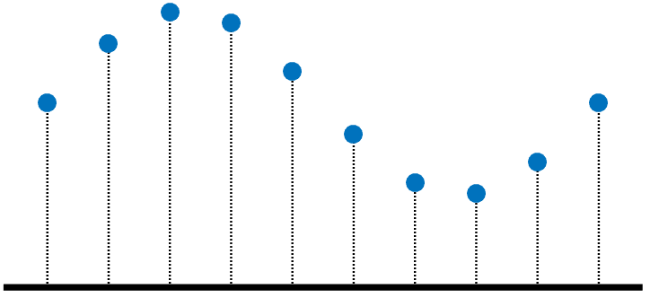

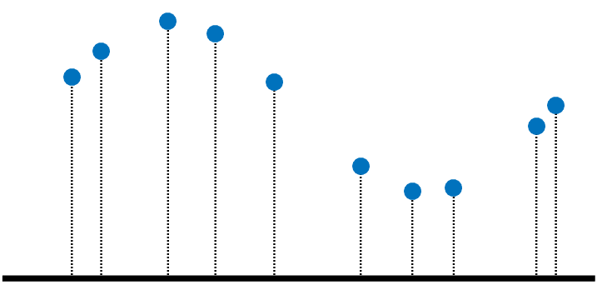
MATLAB Data Acquisition Toolbox (MATLAB DAQ)
Legacy Interface is available for 32-bit MATLAB only and R2015b is the last release of 32-bit MATLAB for Windows. (http://www.mathworks.com/support/sysreq/roadmap.html)
Analog samples are updated at 15-msec intervals during continuous sampling, which is not fast enough for near-realtime behavior monitoring (Asaad & Eskandar, 2008a).
The current solution for the slow sample update is to use two boards together.
Update chunk size
Board 1
Continuous sampling
Accurately timed
Long update interval
For offline analysis
Signal
Split
Update chunk size
Board 2
One sample acquisition
No clock setting
Frequent sample update
For online analysis

Slide 4
NIMH DAQ Toolbox (NIMH DAQ)
A complete replacement of MATLAB DAQ for MonkeyLogic
NIMH DAQ provides MATLAB DAQ’s legacy interface in both 32-bit and 64-bit MATLAB.
➔ MonkeyLogic can run on 64-bit MATLAB.
NIMH DAQ updates acquired samples much faster and more frequently.
➔ One DAQ board is sufficient for near-realtime behavior monitoring.

Slide 5
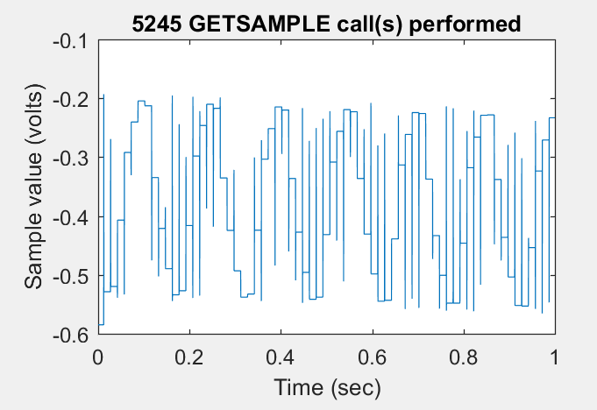
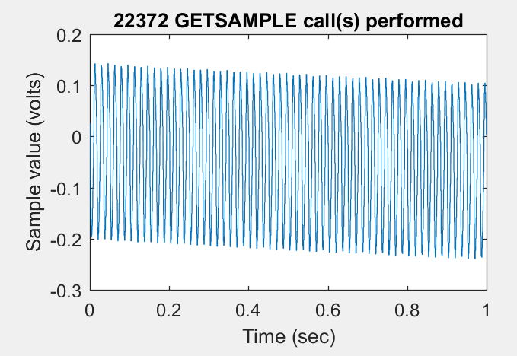
Benchmark
Test for evaluating getsample() performance during continuous acquisition
(sampling rate: 1 kHz)
The task was run on the same computer with the same board.
MATLAB DAQ
NIMH DAQ

Slide 6
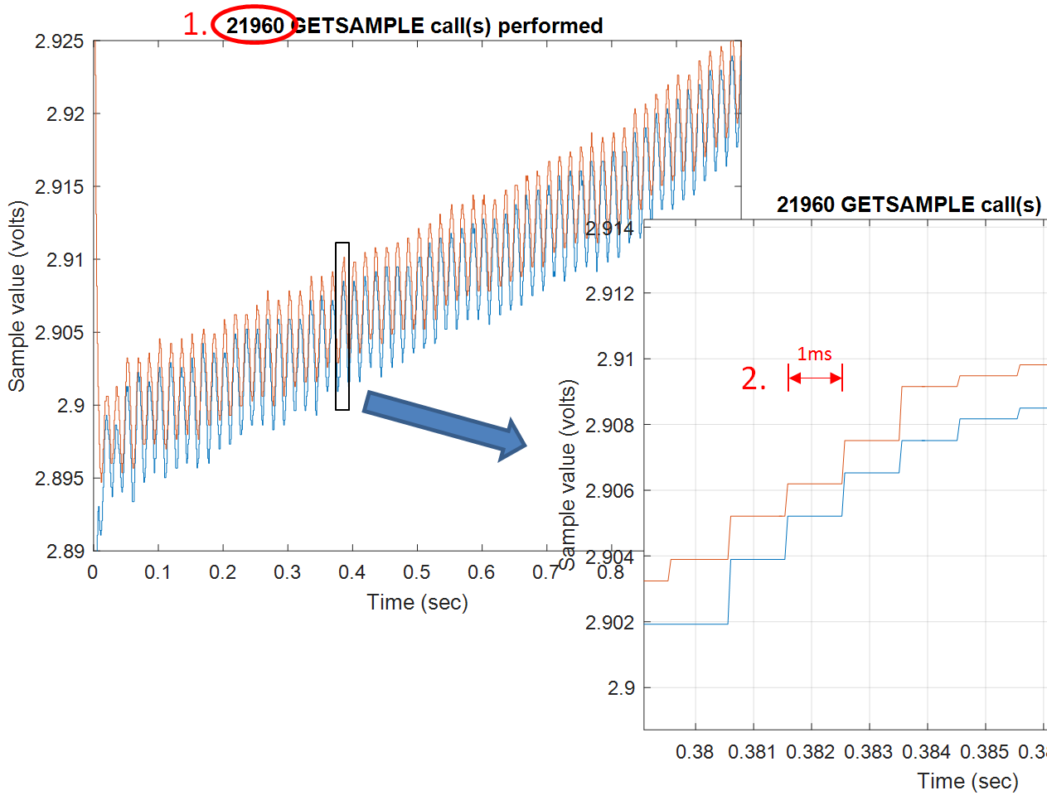
GETSAMPLE during continuous acquisition in NIMH DAQ
Not only is GETSAMPLE performed faster but also samples are updated every milliseconds.

Slide 7


Performance in MonkeyLogic
The same task on the same computer and the same MonkeyLogic setting
Simply replacing MATLAB DAQ with NIMH DAQ increases the MonkeyLogic cycle rate significantly.
MATLAB DAQ
NIMH DAQ

Slide 8
Reference
Asaad WF, Eskandar EN (2008) Achieving behavioral control with millisecond resolution in a high-level programming environment. J Neurosci Methods 173:235-240.

